Slide 1
ABSTRACT
Smart Location Alarm is a web application designed to revolutionize the travel experience by providing real-time notifications to users as they approach their destinations.
Leveraging tracking and integration with mapping services, the app ensures users stay informed about their journey progress without distractions.
The primary goals include enhancing convenience, safety, and reliability for travelers.
With customizable distance settings and a commitment to accuracy, Smart Location Alarm aims to simplify travel while prioritizing user privacy and data security.
The project's objectives include enhancing user engagement, optimizing notification accuracy, and ensuring robust security measures to safeguard user data.
With a focus on customization and continuous improvement based on user feedback, Smart Location Alarm aspires to redefine the way people navigate and stay informed while on the move.

Slide 2
SMART LOCATION ALARM

Slide 3
ABOUT OUR APP
Smart Location Alarm is a web application designed to enhance travel experiences by providing real-time notifications when users reach their destinations. Users input their destination and the app tracks their progress using GPS API. It offers notification, integrates with mapping services, and sends alerts as the destination approaches. Overall, Smart Location Alarm simplifies travel and ensures users arrive at their destinations informed and on time..

Slide 4

GOALS & OBJECTIVES
01
The primary goal of ArriveNotify is to enhance the overall travel experience for users by providing them with timely and relevant notifications and alarm as they reach their destinations.
02
To simplify the travel process by eliminating the need for users to constantly monitor their progress or check navigation apps during their journey.
03
To become a reliable companion for travelers, ensuring accurate notifications and smooth functionality to build trust among users.

Slide 5







Stack used

Slide 6
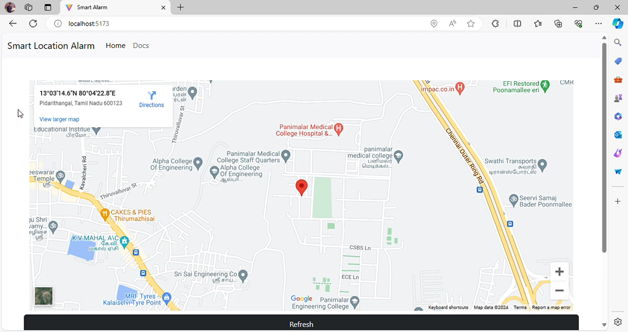

Slide 7
Features
Alert users by sending a notification (SMS) text when user is about to reach the destination
Alert the user by ringing alarm when the destination is reached

Slide 8
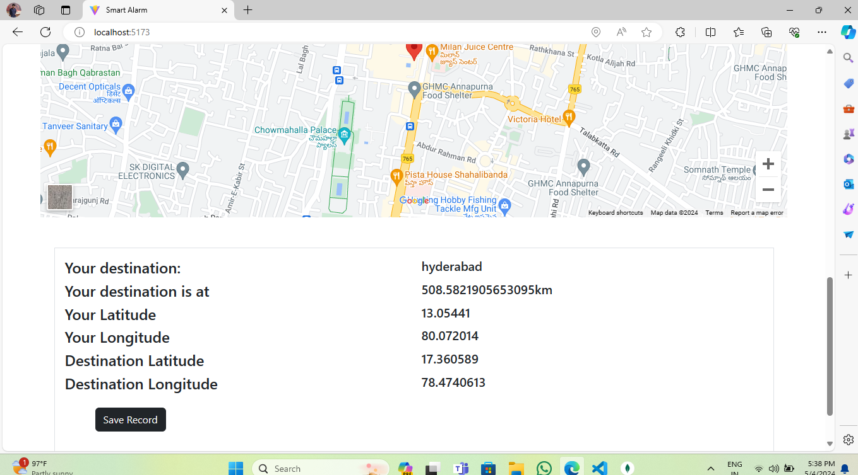
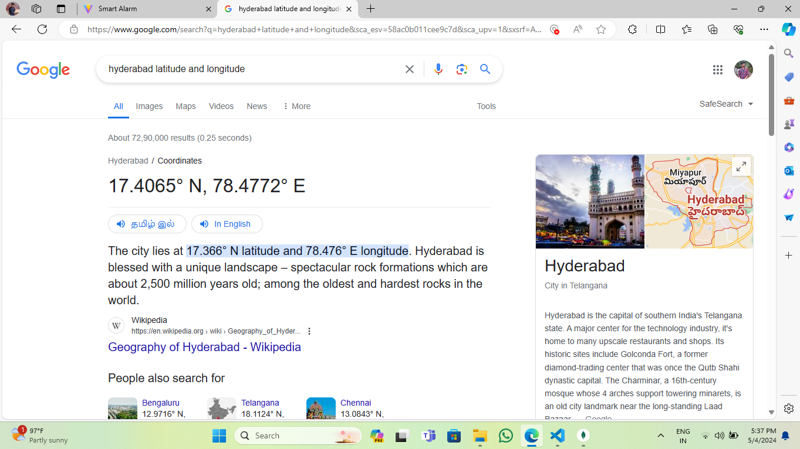
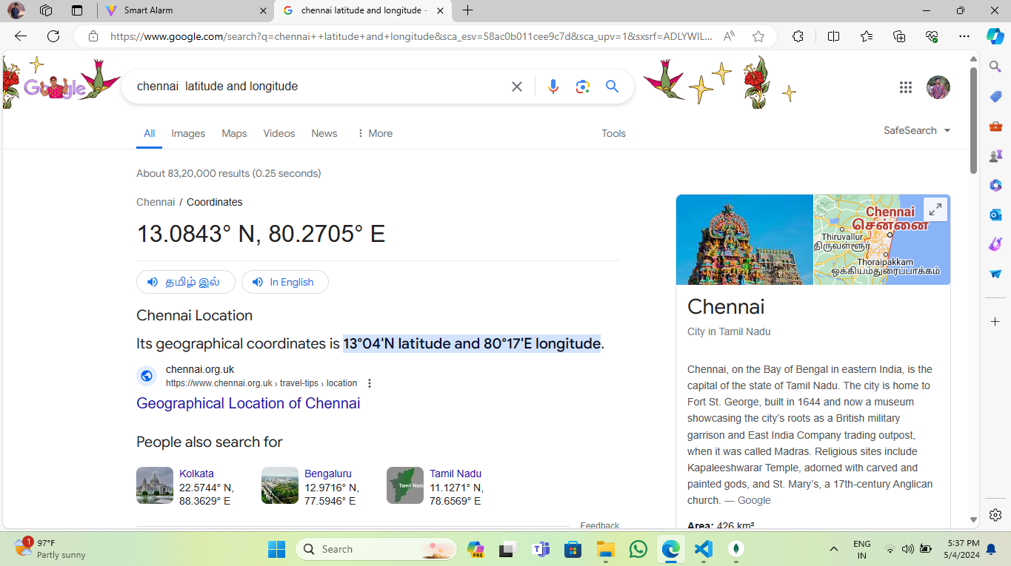

Slide 11


TEAM MATES
Sanjai Kumar R
Kumaran S

Slide 12

TEAM MATES
Santosh Charan R
Tamil Amit Raj

Slide 13
THANKS !

